Slide 1

Web Development Intro
HTML, CSS, JS

Slide 2
Agenda
Understands how the Internet works
Understand the difference between front-end and back-end
HTML, CSS, JavaScript

Slide 3
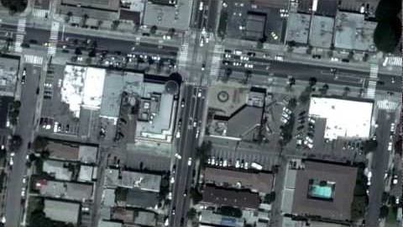
How does Internet Works

Slide 4





How the web works?
https://www.google.com
HTTP Request
Client (Browser)
Server
HTTP Response
Notes:
Computers connected to the web are called clients and servers
Clients are the typical web user’s internet-connected devices.
Server is a dedicated program or a machine which serves the clients based on their requirements.
The internet operates based on conversations between the client (more familiarly known as the browser) and the server(the code running the web site you're trying to load).
By typing in that URL into your browser, you (the client) are requesting a web page.
The server then receives the request, processes it, and sends a response.
The Hypertext Transfer Protocol (HTTP) is designed to enable communications between clients and servers.
HTTP works as a request-response protocol between a client and server.
HTTP Methods: GET, POST, PUT, DELETE, PATCH, OPTIONS
GET is used to request data from a specified resource.
POST is used to send data to a server to create/update a resource.

Slide 5
View Page Source
Right Click + View Page Source

Slide 6
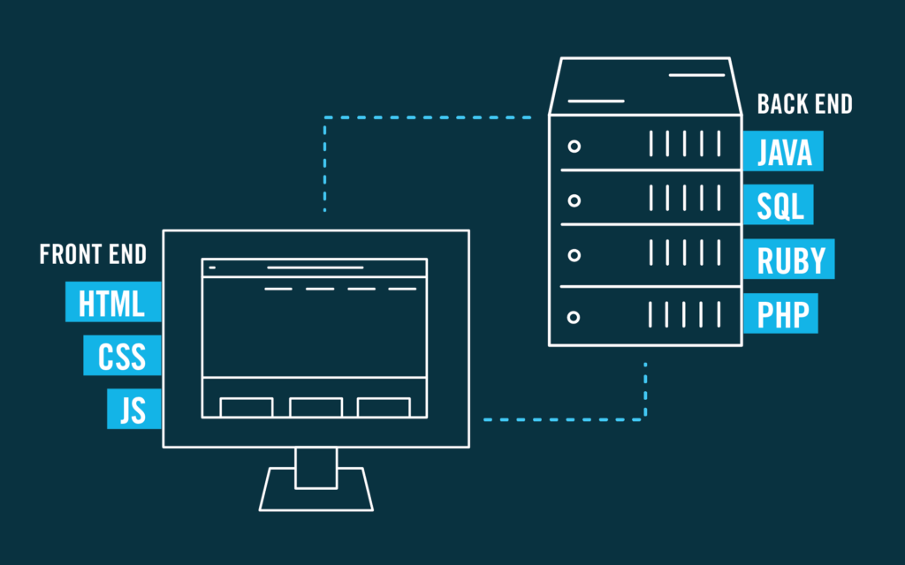
Front-End and Back-End
Notes:
Explain Front end vs back end

Slide 7
Role of HTML, CSS, JS
HTML – Hypertext Markup Language : Defines the structure of a website
CSS – Cascading Style Sheets : Defines the style of HTML
JS – JavaScript : Adds logic and interactivity to a page
Notes:
<h1>Hello World</h1>
<button onclick="myFunction()">Click Me</button>
----------------------------------------------------------------
h1{color:red;}
-----------------------------------------------------------------
function myFunction(){
document.querySelector("h1").style.color = "green";
}

Slide 8
Code pen Example
Create sample.html page

Slide 9
Resources
Slide 3 - https://youtu.be/qEdv_pem-JM
Slide 6 - https://flatironschool.com/blog/front-end-vs-back-end-development
Slide 7 - https://simpliv.wordpress.com/2018/04/12/learn-the-foundations-of-html-css-javascript-from-experts-solidify-your-learning-with-examples/

